Slide 1
Customer Research & Market Insights Analytics
Project 1 • Data Science Capstone
Using customer shopping data to understand behaviour, satisfaction, purchasing patterns and loyalty.
Presented by Francis Chukwunonyere

Slide 2
Project Objective
Turning customer data into actionable business insights
• Understand customer behaviour and purchasing patterns.
• Assess customer satisfaction using review ratings.
• Identify useful demographic, product and shopping trends.
• Use exploratory analysis to support business decisions.
• Translate findings into practical recommendations.
2

Slide 3
Dataset & Data Inspection
The first stage was to understand the structure and quality of the data.
3,900
customer records
18
columns
0
duplicates found
18
variables inspected
• Loaded shopping_trends.csv with Pandas.
• Inspected first and last five records.
• Checked dimensions, column names and data types.
• Checked missing values and duplicate records.
• Generated descriptive statistics before analysis.
3

Slide 4
Data Cleaning
Preparing the dataset for reliable analysis
• Removed duplicate records.
• Handled missing values by removing incomplete rows.
• Standardized gender entries by stripping spaces and converting to uppercase.
• Standardized location values by removing unnecessary spaces.
• Converted purchase amount and review ratings to numeric formats.
• Filtered ages to retain realistic adult customer ages (18–100).
• Performed a final dataset information check.
4

Slide 5
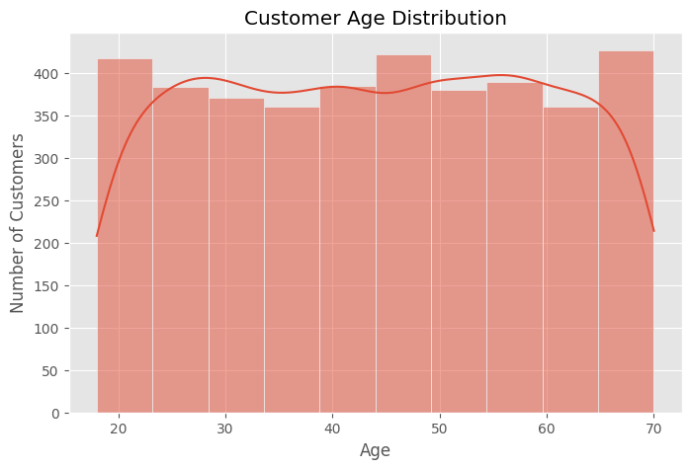
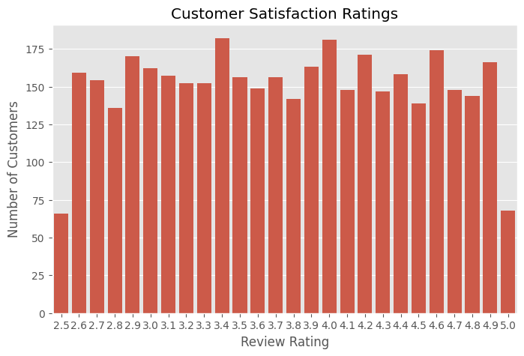
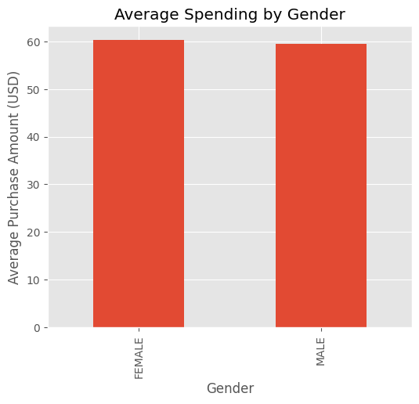
EDA: Customer Profile & Satisfaction
Customer Age Distribution
Customer Satisfaction Ratings
Average Spending by Gender
5

Slide 6
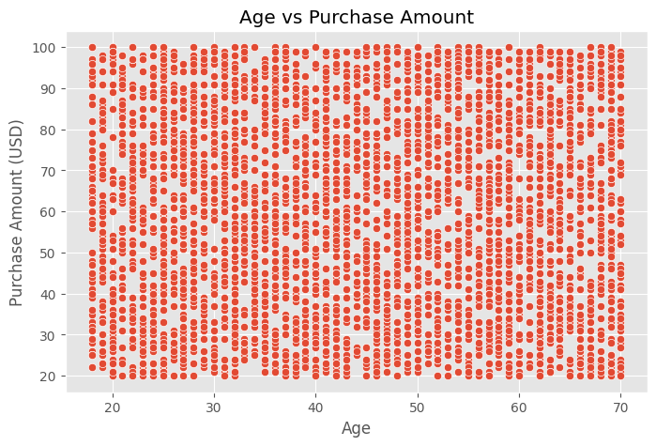
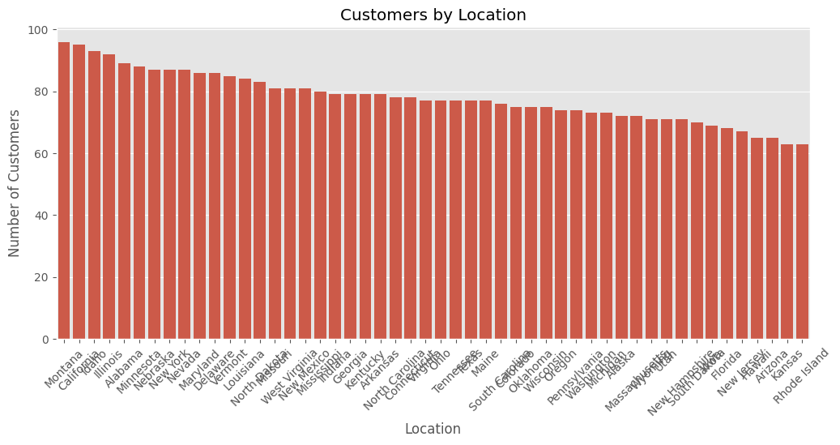
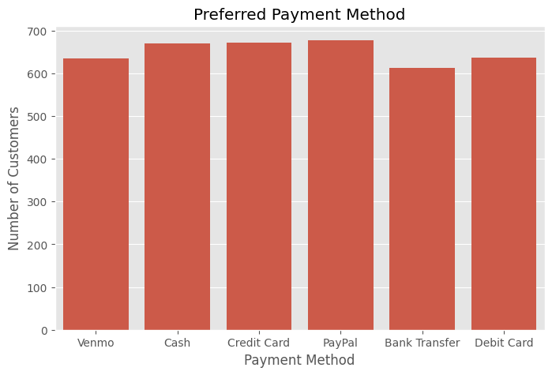
EDA: Purchasing & Customer Distribution
6

Slide 7
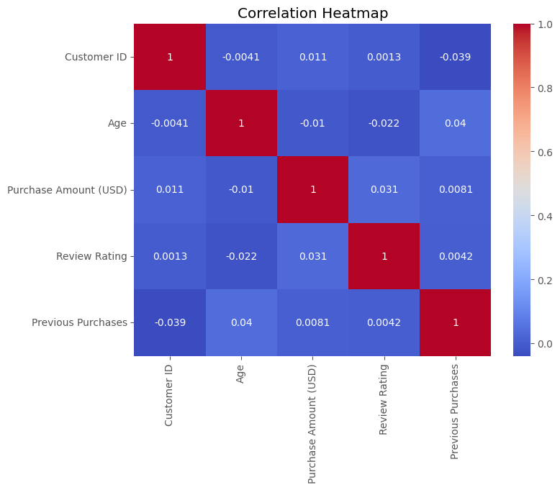
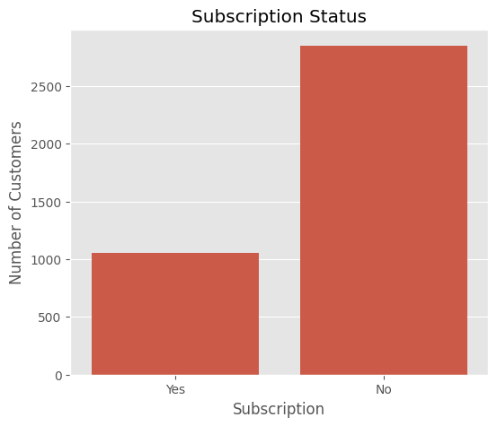
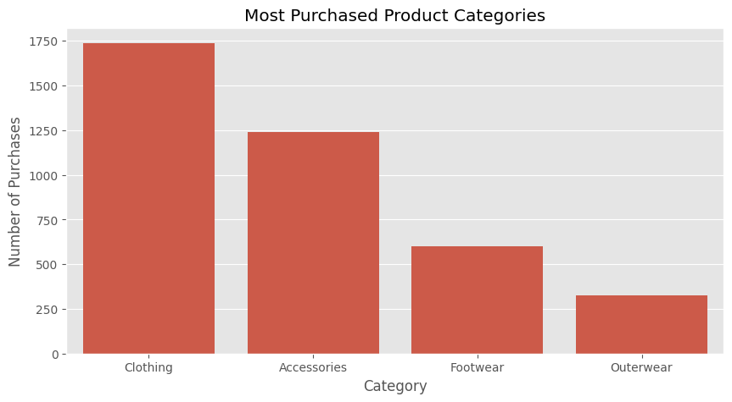
EDA: Relationships, Loyalty & Product Demand
7

Slide 8
Business Insights & Interpretation
What the analysis allows the business to investigate
• Customer targeting: use purchasing activity and demographic patterns to identify valuable groups.
• Satisfaction: review ratings provide a direct measure of customer satisfaction.
• Loyalty: subscription status, purchase frequency and previous purchases are useful loyalty indicators.
• Age and spending: the scatter plot helps assess whether spending varies across age groups.
• Payment preference: payment-method distribution can guide customer convenience and checkout priorities.
• Product demand: category frequency highlights where customer demand is concentrated.
Important dataset limitation
• The selected dataset does not
contain income, annual spending,
communication channel, or a
direct retention-rate field.
• Therefore, those parts of the original
brief were adapted using available
variables rather than inventing data.
8

Slide 9
Business Recommendations
Five actions based on the analysis framework
1
Target high-value customers
Use purchasing activity to identify valuable customer groups and offer personalized promotions.
2
Strengthen loyalty programs
Reward frequent purchasers and active subscribers with points, cashback or exclusive offers.
3
Improve customer satisfaction
Monitor review ratings and address recurring customer concerns promptly.
4
Personalize marketing
Tailor campaigns to age, location and shopping preferences to improve engagement.
5
Use analytics continuously
Regularly monitor purchasing behaviour and shopping trends to support better decisions.
9

Slide 10
Conclusion
The project demonstrates a complete analytics workflow:
• Inspect the data
• Clean and validate the data
• Explore customer behaviour
• Translate patterns into business insights
• Recommend practical actions
10

Slide 11
THANK YOU FOR LISTENING

